Slide 1


University 101
Welcome to Lecture Taking 101

Slide 2
Thank you for joining ☺
I will be talking over the slides. Please use the University 101 Worksheet that was emailed to you to make notes
Record any questions you have and bring them to our individual meeting ☺

Slide 3
What is a Degree?
BA MA PhD
BSc MSc PhD
BEd MEd PhD
BFA MFA
BBA MBA
MD (What is a Diploma?)
DDS
LLB

Slide 4
What is a General vs Honours Degree?
General = 3 years
Honours = 4 years (required for most Master’s and Professional degrees)

Slide 5
How do I choose a university?
What is the best school?
What is the best program?
What are the admission requirements/grades?
What about other considerations: Size? Location? Co-op? Campus atmosphere? Extra-curricular activities?

Slide 6
What is a prerequisite?
A high school course you must successfully complete prior to admission into a particular program (these are non-negotiable)
Graduate/professional degrees will have prerequisites too. These will be required university courses (not high school ones)
This is a matching game!

Slide 7
What is a “major” program of study?
Major
Double major
Major / minor
How do I declare?
Can I change my mind?

Slide 8
How do I choose a major?
‘Compare shop’ programs at different schools
Look at all required courses
www.ontariouniversitiesinfo.ca
https://bhsc.mcmaster.ca/bhsc-core/
http://calendar.uoit.ca/preview_program.php?catoid=20&poid=3658&returnto=826

Slide 9
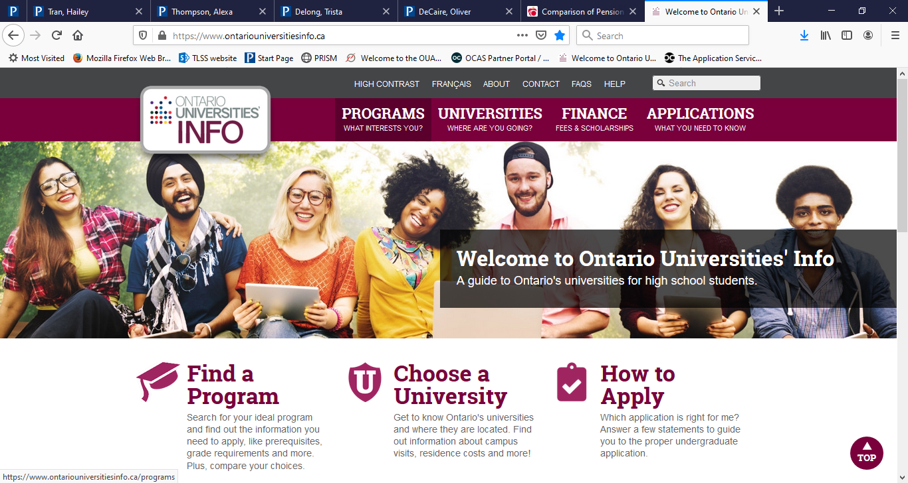

Slide 10
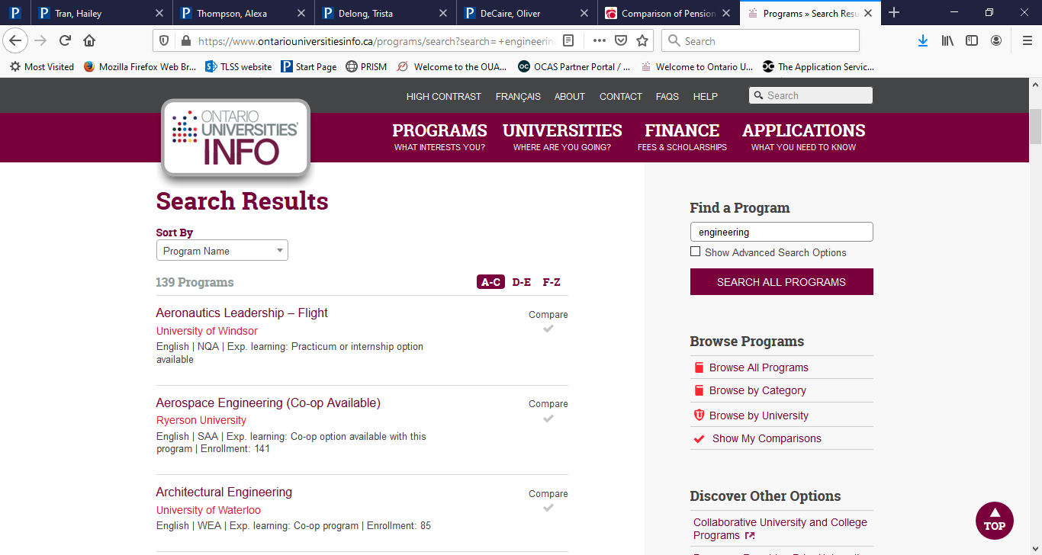

Slide 11
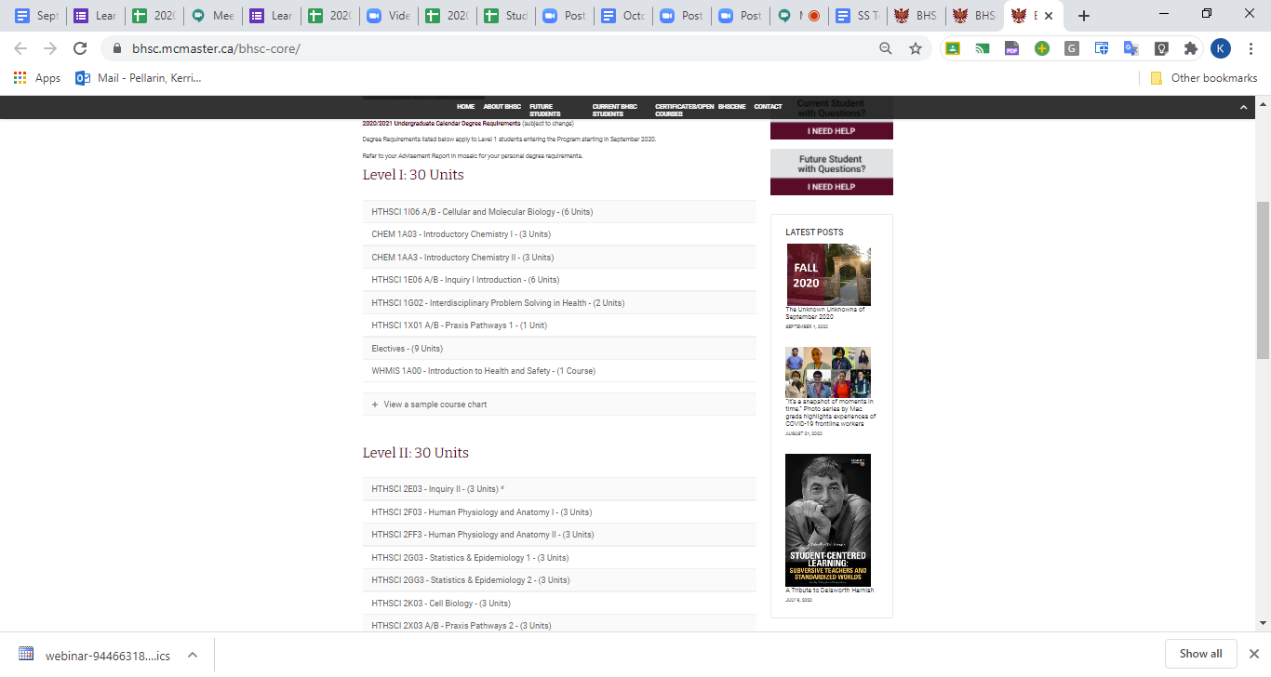

Slide 12
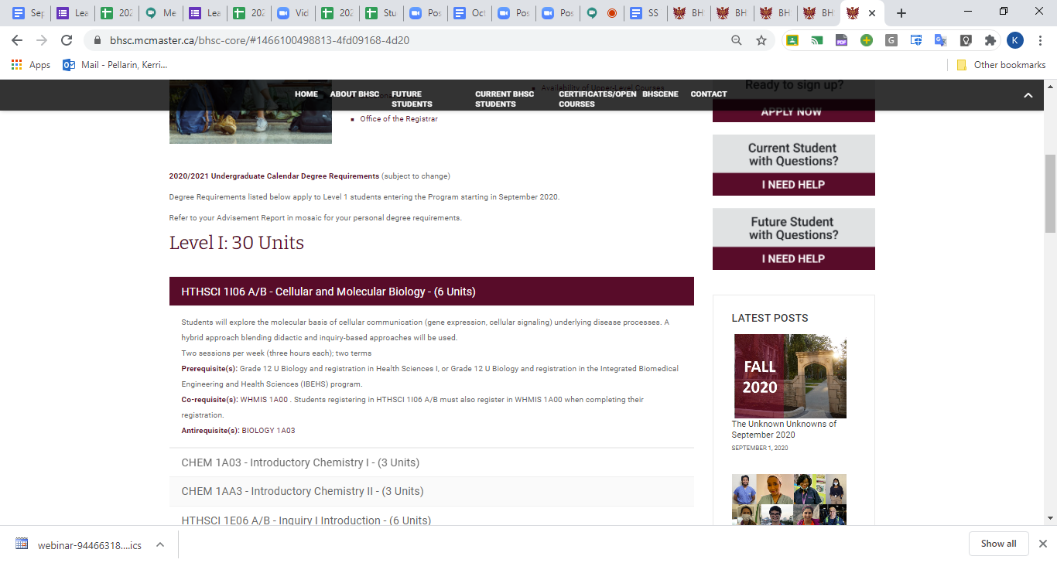

Slide 13
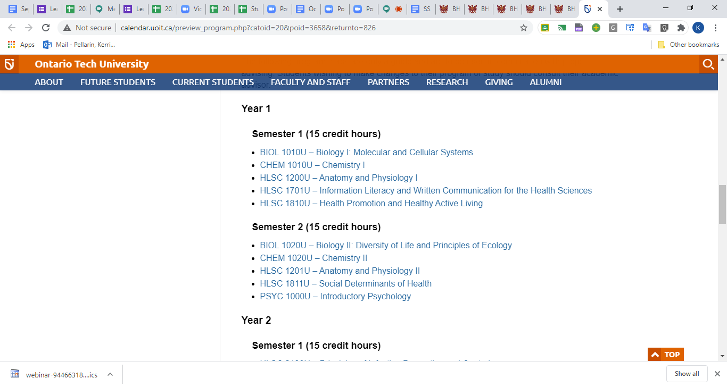

Slide 14
What is an admission average?
ENG4U | 70%
SCH4U | 77%
MFH4U | 79%
SBI4U | 80%
CHY4U | 81%
EWC4U | 85%
SPH4U | 86%
ADMISSION AVERAGE | 80%
Prerequisites:
ENG4U, MFH4U

Slide 15
What is “Additional Admission Information?”
How do I found out about it?

Slide 16
How do universities treat different types of courses?
Repeated courses
Night school / Summer school courses
eLearning

Slide 17
Professional Courses
Medicine, law, dentistry, physiotherapy, speech and language pathology, pharmacy, optometry, etc.
All these programs require prior University studies
They too will have prerequisites but they will be specified UNIVERSITY courses
Check these prerequisites when choosing your university courses – it too is a matching game!
https://www.ouac.on.ca/

Slide 18
How do I visit a campus?
Liaison office
Most tours will be virtual this year
What should I ask about?

Slide 19
How do I find out about universities outside of Ontario?
Individual university websites
Individual deadlines & applications
Please let Mrs. Pelllarin know if you are applying to these or to the USA
www.schoolfinder.com
www.myblueprint.ca

Slide 20
How much will university cost?
$18,000 - $25,000 (with accommodation)
$9,000 - $11,000 (without accommodation)

Slide 21
Personal Wellness
Exercise (student fees)
Cafeteria food
On-site health care professionals
Drug / Dental plan (check student fees)
Social time
Sleep
BALANCE (fun + school)
=== Self-Discipline

Slide 22
How do I find Scholarships?
Scholarship websites
www.studentawards.com
www.scholarshipscanada.com
www.schoolfinder.com
Twitter: Seeking Scholarships
University websites
Bursaries – in ‘awards section’ on post-secondary websites
www.ontariouniversitiesinfo.ca
Guidance

Slide 23
How do I apply?
Not yet….you need a PIN
Mid-late October
https://www.ouac.on.ca/
Application videos, powerpoint and handouts are posted on TLSS website http://twi.scdsb.on.ca/

Slide 24
How many programs can I apply for?
Unlimited, but not more than 3 at any one university
$150 for 3 choices; $50 per choice thereafter
You can delete a choice and add another one for no extra cost IF at SAME school

Slide 25
What if I take a gap year?
Can I defer my acceptance?

Slide 26
What are the programs offered jointly by colleges and universities?
Applied degrees
  https://www.fanshawec.ca/programs/bio2-honours-bachelor-applied-technology-biotechnology/next
  https://www.georgiancollege.ca/academics/full-time-programs/honours-bachelor-of-police-studies-baps/
Collaborative degrees
  https://www.ouac.on.ca/
Articulated degrees (College – University transfer degrees) www.ontransfer.ca

Slide 27
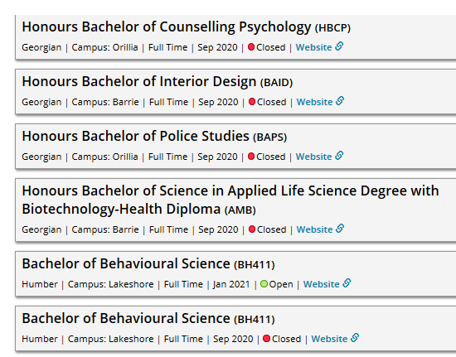

Slide 28
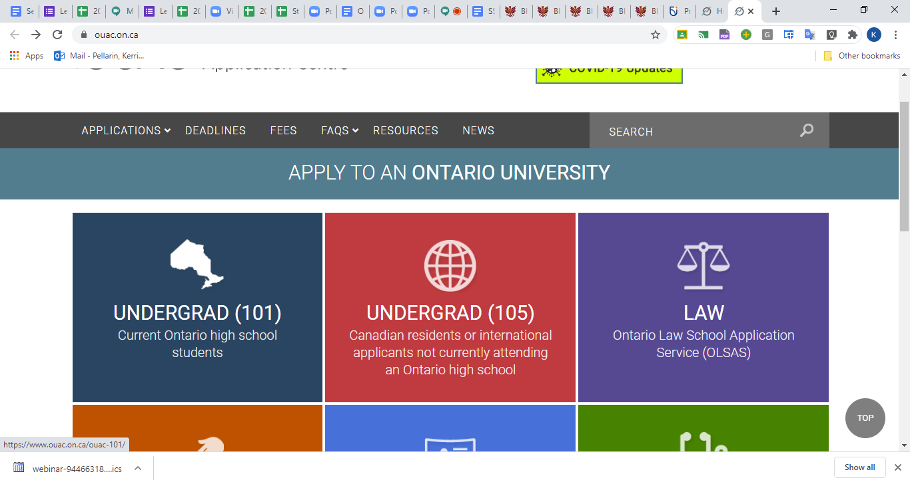

Slide 29
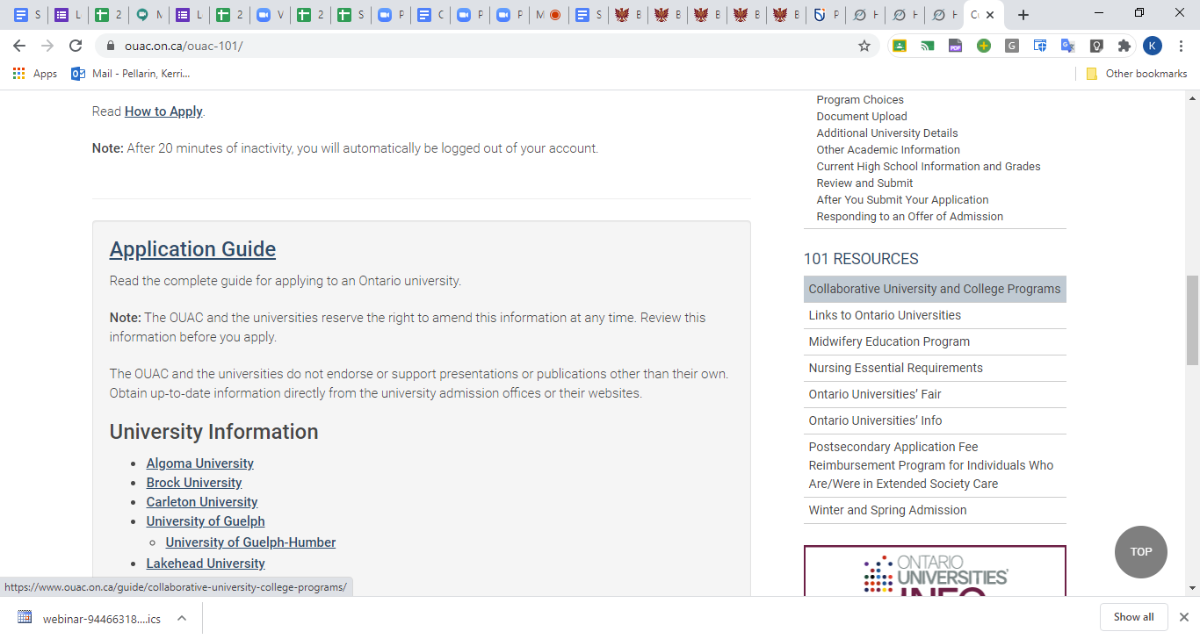

Slide 30
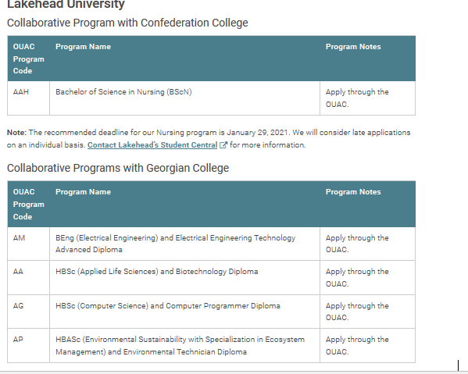

Slide 31
Timeframes
Apply – starting early November
Applications due - January 15, 2021
Latest date to receive a response – May 27, 2021 (CONDITIONAL acceptance or rejection
You confirm acceptance by June 1, 2021
July 2021 – FIRM offer or rescind conditional offer

Slide 32
What is a
‘Conditional’ Offer of Admission?

Slide 33
What is an
‘Alternate’ Offer of Admission?”

Slide 34
Final Offer of Admission
Your offer will be confirmed in July (after semester 2 marks are submitted by TLSS to OUAC)
Your offer may be rescinded if your final sem 2 marks drop below required %

Slide 35
How do I pick my courses?
Will receive a listing of courses after you confirm your acceptance
You need to know: the required courses for your program and the options for electives
Handwrite your timetable (include section numbers!)
Know when and how you submit your courses

Slide 36
What to do if NOT accepted anywhere ?
Call University – am I on a waiting list?
Ontario Universities’ Admission Information Service
  Inquiries about possible openings at other Ontario universities
  June – August
  Service available on OUAC website
  519-823-1063

Slide 37
Good Luck !!
Please come and see me
if you have any
questions
We are your Cheerleaders
☺

